Slide 1

TEMPERATURE CHANGES
USING MIN-MAX-ALGORITHM

Slide 2

TEAM MEMBERS
DIVYA DARSINI U(RA2311003010678)
R NANDHANA(RA2311003010689)
SWETHA SM(RA2311003010703)

Slide 3
CONTRIBUTION of divya darsini u
JavaScript Logic & Algorithm Implementation
Developed the core logic for the Min-Max algorithm using JavaScript to efficiently find the lowest and highest temperature from the user input.
Handled user input processing, converting comma-separated values into an array of numbers for accurate calculations.
Implemented event handling for the button click, ensuring the function executes dynamically when the user submits data.
Optimized the algorithm using Math.min() and Math.max(), ensuring quick and accurate results without unnecessary computations.
Added validation checks to handle incorrect inputs (such as non-numeric values or empty fields) and provided appropriate error messages.

Slide 4
CONTRIBUTION of r nandhana
Frontend Development (HTML & CSS)
Designed Webpage Layout – Created structured HTML elements for input, button, and result display using semantic tags.
Implemented Responsive Design – Used CSS flexbox and media queries to ensure adaptability across different screen sizes.
Styled UI for Better Appearance – Applied color schemes, fonts, padding, and hover effects for an appealing look.
Enhanced User Interaction – Added error message styling, button animations, and smooth transitions for better UX.
Optimized Accessibility & Usability – Ensured clean structure, proper spacing, and readable text for ease of use.

Slide 5
CONTRIBUTION of swetha s m
Testing, Debugging, and Optimization
Conducted thorough testing with multiple temperature datasets, including edge cases like negative temperatures, decimals, and extreme values.
Debugged issues related to incorrect input formats, empty input fields, and UI responsiveness to enhance overall user experience.
Improved error handling mechanisms, ensuring that users receive proper feedback when entering invalid values.
Suggested UI/UX improvements, such as using icons and proper formatting of output results.
Provided final optimization, ensuring the application loads quickly and executes efficiently on various browsers.

Slide 6
INTRODUCTION TO TEMPERATURE CHANGE USING MIN-MAX ALGORITHM
The Min-Max Algorithm can be used to analyze temperature variations over a given period to determine extreme values—the minimum and maximum temperatures. This can be useful in climate analysis, weather forecasting, and environmental monitoring.

Slide 7
PROJECT EXECUTION
INITIAL PHASE
SCENE UPDATE
Define an array with temperature values ranging from 24°C to 30°C.
Initialize minTemperature and maxTemperature variables with the first temperature value.
Get the temperature box, sky, temperature text, and Min/Max text elements using document.getElementById().
Use Min-Max normalization to scale temperature values between 0 and 1.
Display the current temperature above the box.
Keep Min & Max temperature visible at the top.
Adjust text color dynamically to maintain visibility at higher temperatures.

Slide 8
PROJECT EXECUTION
EXECUTION AND LOOPING
FINAL EXECUTION
Initialize variables & get A-Frame elements.
Call updateScene(temp) to modify the VR environment.
Pause for 5 seconds before increasing the temperature.
Update Min & Max temperature values dynamically.
Loop back to continue updating the scene with the next temperature.
Instead of rapid updates, use setTimeout() to hold each temperature for 5 seconds before increasing.
Cycle through temperatures one by one, looping back to the start when reaching the end.
Function is self-calling to keep updating temperatures indefinitely.

Slide 9
time complexity analysis
divide and conquer method
Divide Step: The array is recursively divided into two halves.
Conquer Step: The minimum and maximum values are found in each half.
Combine Step: The two halves are merged by comparing the results.

Slide 10
time complexity analysis
divide and conquer method
BEST CASE COMPLEXITY:O(1)
The best case occurs when the number of elements is already minimal that is only one element is present
AVERAGE CASE COMPLEXITY:O(N)
It occurs when the array elements are randomely distributed
WORST CASE COMPLEXITY:O(N)
The worst case occurs when we have to divide the array completely into single elements making the maximum number of recursive calls

Slide 11
time complexity analysis
divide and conquer method
If we denote the time complexity as T(n) for an array of size n, the recurrence relation is: T(n)=2T(n/2)+2
T(n/2)=2[2T(n/4)+2]+2=4T(n/4)+4+2;
T(n)=2^kT(n/2^k)+2^k-2;
when n/2^k=1 ,we get,k=log2n;
T(n)=2log2nT(1)+2log2n-2,
Since 2log2n=n and T(1)=1,we get T(n)=2n-2
i.e,T(n)=O(n)

Slide 12
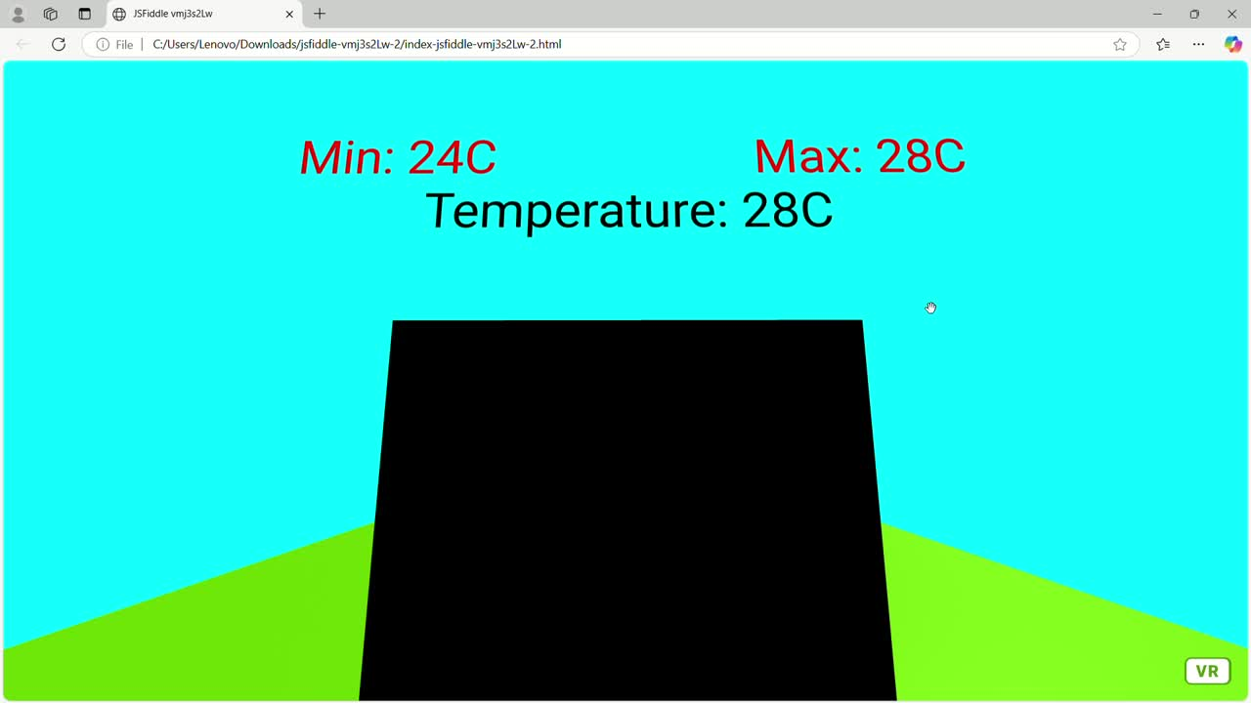
OUTPUT RESULTS

Slide 13
THANKYOU

